Slide 1
SASI-ITE'24 Conference HUMAN ACTIVITY RECOGNITION WITH CNN IN FASTAI
Parvathaneni Naga Srinivasu
Bonu Rahul Karthik
A J K Naga Chaitanya
Bolliboiyna Sivaraju
Galinki Deepak
Abbineni Sivamani Kumar

Slide 2
ABSTRACT
Human activity recognition (HAR) is the designated term for the automated identification of physical activities conducted by individuals. The current study analyzes convolutional neural networks (CNN) in human activity recognition, particularly on datasets including images. Researchers and developers can gain valuable insights into human behavior by accurately recognizing human activities in image datasets. Here, we developed a deep learning model that classifies different activity classes like sitting, standing, sleeping, and walking. To assess the model's efficacy, our research utilizes a comprehensive dataset from Kaggle's repository, namely the Activity Dataset. This dataset encompasses a wide range of authentic and varied activity events. It offers various annotated images capturing human activities like sitting, standing, walking, and sleeping across different environments and contexts. This research introduces a cutting-edge approach to HAR using CNN, empowered by the FastAI library, which offers an efficient and user-friendly platform for deep learning

Slide 3
SCOPE
Healthcare Monitoring :
Rehabilitation Monitoring
Fall Detection and Prevention
Activity Monitoring for Chronic Disease Management
Public Safety and Security :
Anomaly Detection and Threat Identification
Crowd Monitoring and Management
Perimeter Security and Access Control

Slide 4
SCOPE
Sports Performance Monitoring:
Biomechanical Analysis and Technique Optimization
Injury Prevention and Rehabilitation
Performance Tracking and Feedback
Emergency Response Systems:
Disaster Response and Search and Rescue
Remote Monitoring of Hazardous Environments
Coordination of Emergency Responders

Slide 5
OBJECTIVES
This model aims to automate the process of detecting and classifying human activities in images, eliminating the need for manual intervention and providing an efficient solution to the challenges posed by traditional methods.
Develop a deep learning model that can handle variations in lighting, background, and other environmental factors for consistent performance across diverse scenarios.
Enable CNN model to distinguish between multiple activity classes effectively and the utilization of FastAI is particularly emphasized for its ability to automate tasks such as network architecture design and hyperparameter tuning, making the overall model development more streamlined and accessible

Slide 6
PROBLEM STATEMENT
Develop a deep learning model using Convolutional Neural Network in FastAI for the task of Human Activity Recognition based on image dataset.

Slide 7
LITERATURE REVIEW
Zhenguo et al :
Explored Recurrent Neural Networks (RNNs) for HAR with temporal sequences.
Identified limitations, including dependence on precise Channel State Information (CSI) data. Highlighted challenges in real-world scenarios: obtaining high-quality CSI and computational intensity.
Emphasized potential difficulties in real-time processing and scalability due to resource constraints.
Khemchandani et al :
Implemented a robust least squares twin support vector machine for HAR.
Identified challenges: noise within closely linked activity classes and training/testing complexity.
Highlighted issues related to sensitivity to hyperparameter choices and computational overhead.

Slide 8
Diego et al :
Proposed an architecture involving feature extraction and Random Forest (RF) classifier.
Challenges included limited feature representation and sensitivity to feature extraction quality.
Computational complexity, difficulties in hyperparameter optimization, and limited adaptability were discussed.
Martinez-Hernandez et al :
Explored gait categorization using a flexible Bayesian inference system (BasIS).
Identified challenges, such as the need for substantial labeled training data and dependence on accurate sensor data.
Privacy concerns and continuous sensor data requirements were acknowledged.

Slide 9
CONTRIBUTIONS
Human activity detection has the ability to follow patients' movements and discover evident issues such as falls, stumbling, and other symptoms of deterioration. This insight may be used to respond swiftly and improve patient health outcomes.
It might be used to monitor traffic and detect any suspicious conduct to protect everyone's safety. This might help make our neighbourhood, businesses, and homes safer and more secure.
It also promotes the study and development of devices that persons with impairments may utilize to live more independent lives.
It may be used to operate machines and help in the event of a fall or other emergency. It may be used to monitor how well athletes are performing, offer constructive feedback on their technique, and identify areas for progress.
This information might also be used to build new training tactics and routines.

Slide 10
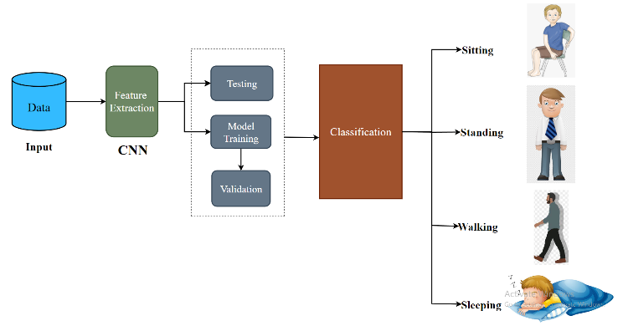
PROPOSED METHODOLOGY

Slide 11
PROPOSED METHODOLOGY
The architectural framework of the CNN model is established, determining the layers' quantity and nature. The feature extraction process involves extracting relevant characteristics from input images. The model is then trained using training data, acquiring knowledge of the relationship between features and target labels.
After training, the model can classify novel images by making predictions based on extracted features. Evaluation is performed using a separate testing dataset to ensure impartial assessment. Additionally, a validation set is used during training to assess performance and refine parameters objectively.

Slide 12
PROPOSED METHODOLOGY
CNNs utilize layers including input, convolutional, pooling, and fully connected layers. Convolutional layers extract image features, which are then sampled by pooling layers to save processing time. Fully connected layers generate final predictions. The network improves filter quality through backpropagation and gradient descent algorithms.
The model can categorize the given input images into different activity classes like sitting, standing, walking, sleeping.

Slide 13
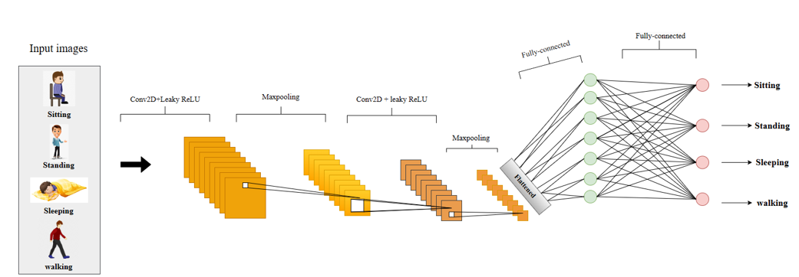
CNN Architecture to implement HAR

Slide 14
CONVOLUTIONAL LAYER:
The mathematical procedure for combining two functions to create a third function is known as convolution. It integrates two data sets.
It's simple application of a filter to an input that results in an activation. Repeated application of same filter to an input results in a map of activations called feature map, indicating the locations and strength of a detected feature in an input such as an image.
This filter is also called as kernel or feature detector and its dimensions can be for example 3*3.To perform convolution, the kernel goes over the input image doing matrix multiplication element after the element. The result for each receptive field(the area where convolution takes place) is written down in the feature map.

Slide 15
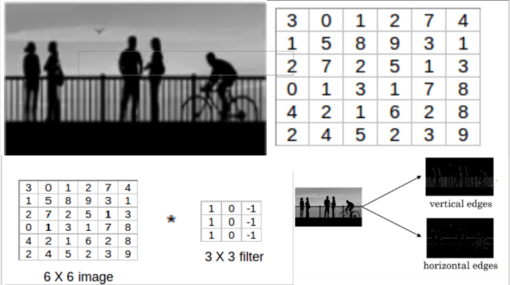

Slide 16
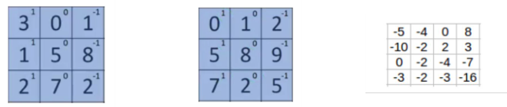
A dot product is the element-wise multiplication between the filter-sized patch of the input and filter, which is then summed, always resulting in a single value. Because it results in a single value, the operation is often referred to as the “scalar product“.

Slide 17
MAX POOL LAYER:
The main purpose of pooling layer is to progressively reduce the spatial size of the input image, so that number of computations in the network are reduced.
Pooling performs down-sampling by reducing the size and sends only the important data to next layers in CNN.
The pooling operation involves sliding a two-dimensional filter over each channel of feature map and summarizing the features lying within the region covered by the filter.
Max pooling is a pooling operation that selects the maximum element from the region of the feature map covered by the filter. Thus, the output after max-pooling layer would be a feature map containing the most prominent features of the previous feature map.

Slide 18
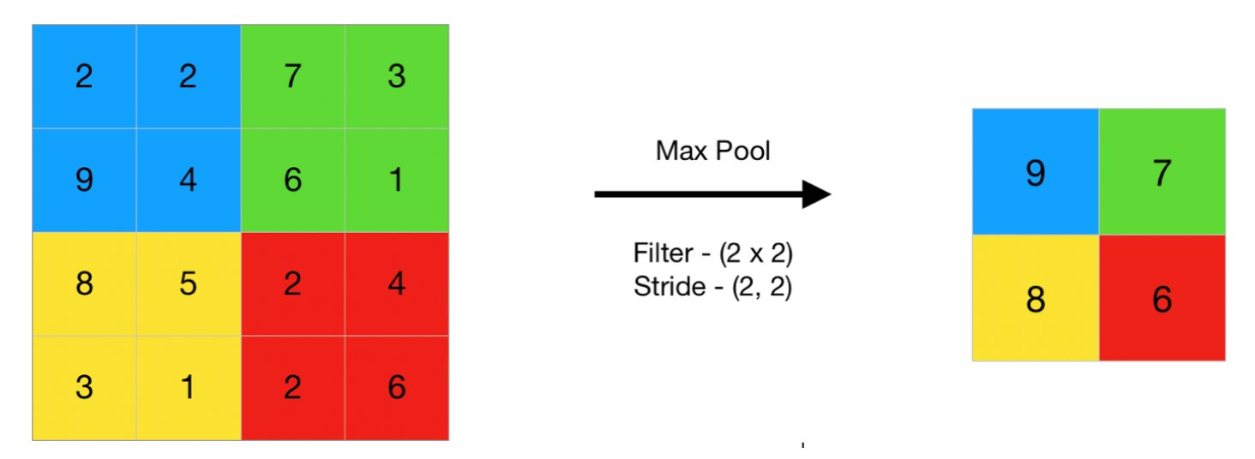

Slide 19
FLATTENING LAYER:
The resulting feature maps are flattened into a one-dimensional vector after the convolution and pooling layers so they can be passed into a completely linked layer for categorization or regression.
FULL CONNECTED LAYER:
It takes the input from the previous layer and computes the final classification or regression task.
FASTAI:
FastAI is a highly regarded deep learning library that offers advanced libraries and modules to professionals, enabling them to achieve fast and efficient state-of-the-art outcomes in deep learning.
The FastAI framework focuses on three key design objectives: high productivity, ease of configuration and flexibility.
It serves as a foundational components for the framework.
The CNN model, enhanced by the FastAI framework, is designed to acquire knowledge and discern significant elements from input about human activity detection.
Subsequently, the fully connected layer uses the extracted characteristics to make predictions about the activity class of the input image

Slide 20
CONCLUSION
This study aims to identify and classify various activities undertaken by human participants into distinct activity categories, such as standing, sitting, walking, and sleeping. This research presents a CNN architecture that demonstrates a capacity for achieving exceptional accuracy in image classification tasks, rendering it well-suited for detecting human activities. The actions within the activity dataset are detected using the FastAI framework in the CNN architecture. The use of CNN inside the FastAI framework for human activity detection has considerable potential due to its ability to achieve high levels of accuracy, facilitate rapid feature learning, and provide the ease of a robust computational framework. The findings derived from this study show superior performance compared to other previously suggested methodologies. The suggested model demonstrated a level of accuracy of roughly 97%. The deep learning model described in this study has the potential to be further improved for various human activities via the use of diverse data augmentation approaches. An additional avenue for further investigation may include the dataset's expansion and diversification, potentially enhancing the model's performance. In light of privacy and ethical considerations, particularly when the project involves surveillance of human behaviors in sensitive or private settings.

